Slide 1
TensileConv
Wong,Fei
AUG.2018

Slide 2
OUTLINE
Auto-tuning method
  Framework
  Workflow
  Parameter space
Prefetch method
  Workload Design
  Data path Design
  Theoretical Performance
  Pipeline Design
  Prefetch method
Performance
Future Work

Slide 3
Auto tuning
  Tensile Conv use a Auto-Tuning method which is to auto generate convolution kernel code and achieve peak performance
    For all WHCKN size
    For different kernel size : 1x1(for now) 1x7 1x3 etc
    For fusion opts: Conv (for now), bias, active
    For different hardware ISA: gfx900 (for now)

Slide 4
Auto tuning – framework
  A generic framework
    support multi problem type : convolution, gemm …
    Support multiple solution type for one problem : (for convolution ): direct, gemm…
    Support multiple kernel language : opencl, gas assembly
  C++ interface

Slide 5
Auto tuning – workflow
Go through all problem parameters
  Each kernel will be run for 100 times and gather the average performance data
  Configuration for the best performance will be record
Generate one problem handle
Go through all solutions
Generate one solution handle
Go through all kernel config
Generate kernel code
Launch kernel
Gather performance data

Slide 6
Auto tuning – parameter space
  Problem parameter :
    W/H: 7, 14, 28, 56, 112 …
    Input / output channels : 64, 128, 256, 512, 1024, 2048 …
    Batch size : 1, 2, 4, 8, 16, 32 …
  Kernel parameter
    K_out_maps : 2, 4, 8, 16, 32
    Local size : 64, 128, 256, 512
  Kernel method
    Buffer number : 2, 3
    Prefetch method
  Instruction : buffer_load_, global_load_ …

Slide 7
Prefetch
  Tensile Conv use a Prefetch method which could prefetch weight date into SQC before use them . Therefore the kernel will hit SQC during convolution loop work .
    Image and weight loading could use different data path
    Hide L1 and SQC latency as much as possible

Slide 8
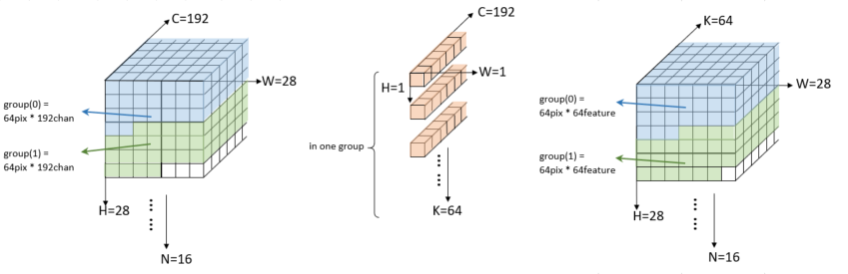
Prefetch - Workload design
  Input data :
    One thread: 1 pixel (W*H=1), ¼ ~ 1 input channel
    Threads in one workgroup : 64 pixel , same input channels
  Weight :
    One thread: 2~32 output channels
    Threads in one workgroup : same output channels
  Output :
    One thread : 1 pixel (W*H=1), 2~32 output channels
    Threads in one workgroup : 64 pixel , same output channels

Slide 9
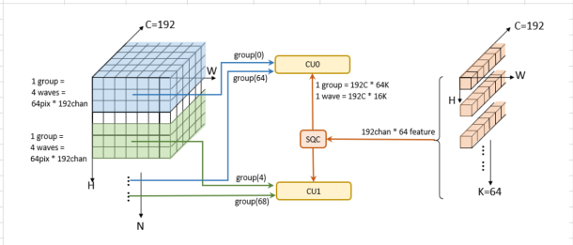
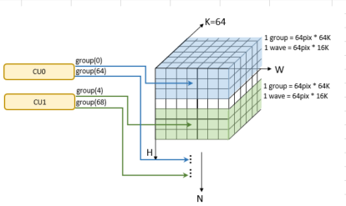
Prefetch - Data path
  Input data :
    L2 --> L1 --> register
  Weight：
    L2 --> SQC --> register
    2 adjacent CUs share one SQC
  Result store :
    Register --> L1 --> L2

Slide 10
Prefetch - Theoretical efficiency
  Parameter :
    Bandwidth : 4 DWORD per cycle
    Operation : 64 opts per cycle
  Formula (for one wave):
    Image read :
      L2 --> L1 : Pixel_maps * C / 4
      L1 --> registers : Pixel_maps * C / 4
    Weight read :
      L2 --> SQC : C * K_maps / 2 / 4
      SQC --> registers : C * K_maps / 4
    Result store :
      Register --> L1 : Pixel _maps * K_maps / 4
      L1 --> L2 : Pixel_maps * K_maps / 4
    Calculation :
      Pixel_maps * C _maps * K_maps / 64
  e.g. W*H*C*K*N = 7*7*192*64*16:

Slide 11
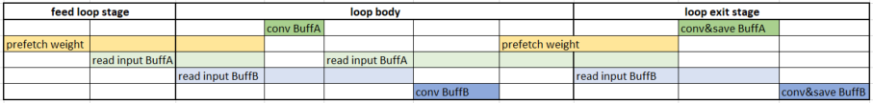
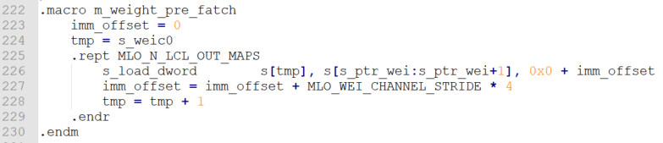
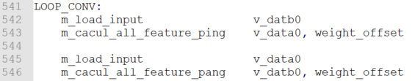
Prefetch - Pipeline design
  Hide SQC latency for weight loading :
    fetch 16 DWORD before each Conv loop
    fetch 16 cache lines from L2 to SQC
    using s_load_dword instruction but not wait
  Hide L1 latency for input image loading :
    Using dual-buffer: Conv buffer B while loading buffer A

Slide 12
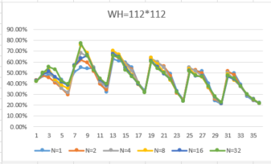
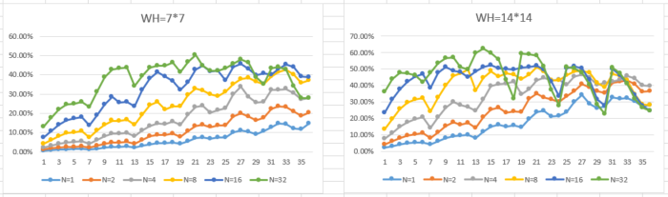
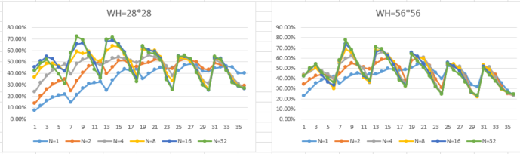
Performance
  Efficiency for large WHNCK range:
    W/H = 7, 14, 28, 56, 112
    C / K = 64, 128, 256, 1024, 2048
    N = 1, 2, 4, 8, 16, 32
  Run 100 times for each case , and gathered average performance
X Axial ID meaning (different W/H combination ):
  Best efficiency is 77.5%
  Performance drop while input channels growing
  Performance drop for small batch size

Slide 13
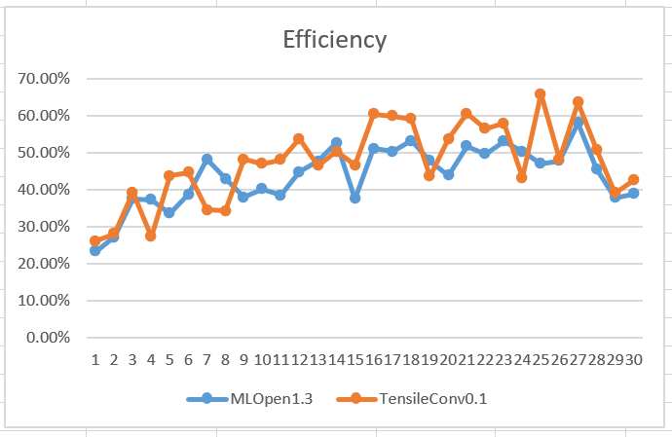
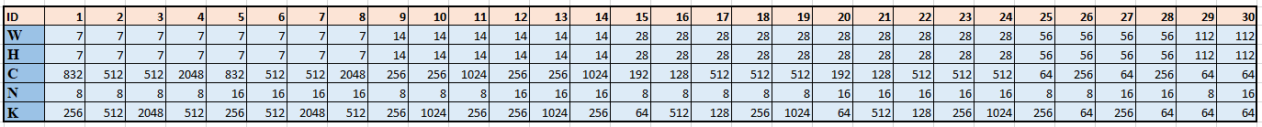
Performance
  Efficiency for typical net work compared with miopen 1.3:
    Performance drop for large input channels
X Axial ID meaning (different NCHWK combination ):
  X Axial ID meaning :

Slide 14
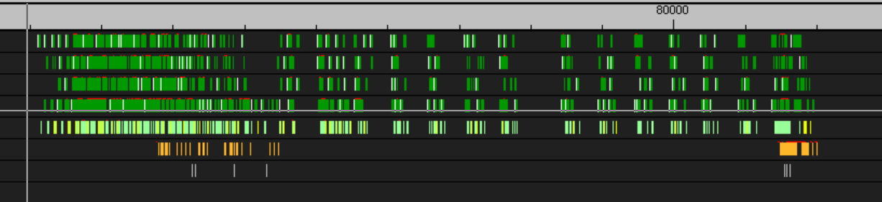
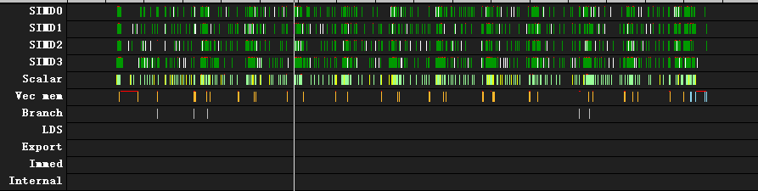
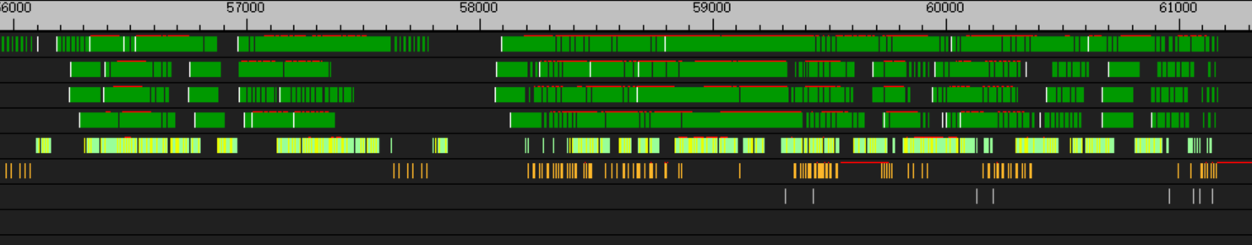
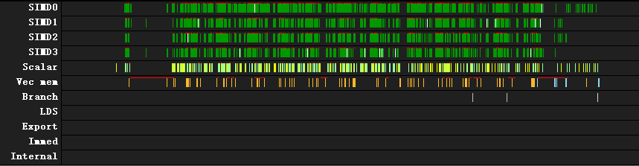
Performance
  Thread trace without prefetch : 169528 cycle
    Weight miss in SQC for each Conv loop
SQC miss: 6488 cycle
169528 cycle
  Thread trace with prefetch : 102296 cycle
    Weight hit in SQC for each Conv loop
SQC hit : 3144 cycle
102296 cycle

Slide 15
Future work
  More hardware and ISA support
  More tuning parameters
  More convolution kernel size
  More date type support
  Fusion option support
  New prefetch method

